Slide 1
Predicting Accident Severity
Rohan Verma

Slide 2
Introduction
The problem statement is to identify the probability and severity of an accident on a particular day and in a particular weather. Various factors like weather, time, day, road conditions etc will be analysed to predict what type of accidents can occur during that time. Moreover, severity of an accident will also be predicted.

Slide 3
Target Audience
This problem will be of interest to residents of Seattle and people who are travelling to/from Seattle. Solution to this problem would help these people to travel safely. It would help people in understanding the risks of travelling on a particular day depending upon the weather conditions. For ex: If a person who wants to travel to Seattle on a rainy day at night, he/she can check chances of an accident and its severity. Consequently, making the decision of travelling or not.

Slide 4
Data Gathering
“Collisions—All Years” dataset was used for this problem. Metadata of this dataset can be found on this link : https://s3.us.cloud-object-storage.appdomain.cloud/cf-courses-data/CognitiveClass/DP0701EN/version-2/Metadata.pdf
Dataset can be downloaded from this link : https://s3.us.cloud-object-storage.appdomain.cloud/cf-courses-data/CognitiveClass/DP0701EN/version-2/Data-Collisions.csv
This data set has around 200k observations and 37 attributes. SEVERITYCODE of the accident is used as a label and this will be used in the end to check the severity of the accident that can occur given other conditions.

Slide 5
Understating data
Some attributes in the dataset like LOCATION, EXCEPTRSNCODE, EXCEPTRSNDESC, SEVERITYCODE, PEDROWNOTGRNT or SPEEDING cannot be used directly. Some of these columns have missing values that need to addressed properly and some columns like REPORTNO and LOCATION cannot be used entirely.
Moreover, few columns like LIGHTCOND, ROADCOND, JUNCTIONTYPE, ADDRTYPE, WEATHER will have to be hot encoded for proper data modelling.
Columns like OBJECTID, INCKEY, COLDETKEY, REPORTNO cannot be used in model creation as these columns do not have the information required to predict accident severity.

Slide 6
Methodology
Data Pre-processing
After looking at every data column, it was evident that only few columns can be used for model training. After dropping trivial columns from the data, only 'SEVERITYCODE', 'ADDRTYPE', 'WEATHER', 'ROADCOND', 'LIGHTCOND' were left.
After removing unnecessary columns down-sampling was done to make SEVERITYCODE 1 and 2 accident values balanced
Next step was dealing with missing values and categorical variables.

Slide 7
Model training
For prediction of accident severity three different algorithms were used: Random Forest, K-Nearest and Logistic Regression.
Random Forest Classifier was used to train the data initially. However initial accuracy was just around 58%. Later, using Grid Search to find best parameters, accuracy was increased to nearly 72%.
Therefore, Random forest with best parameters and accuracy of 71.76% was finalised.

Slide 8
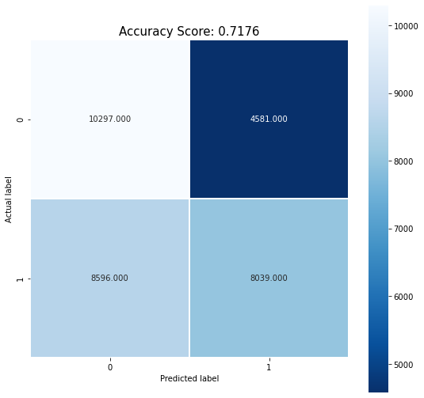
Results
Final predictions results of accident severity were:
Average Error: 0.4185 degrees.
Accuracy = 71.76%.

Slide 9
Discussion and Conclusion
The final results of this model can be greatly improved by more data. In the dataset used, the data was unbalanced and most of the attributes could not be used for prediction of accident severity.
To conclude, weather, road and lighting conditions can accurately predict the accident severity three-fourth of the time. However, more data and more attributes as discussed above can be very useful in accurate prediction.

